Slide 1

Session 7 – Python
Brief Intro to Machine Learning with Scikit Learn
Linear Classifier Models
Doug Bowman

Slide 2
Linear Models
List of some types we will Cover
  Linear Classifiers
    K-Nearest Neighbors
    Decision Tree
    Logistic Regression
      Misleading name
    Support Vector Classifier

Slide 3
Linear Models
Models differ in:
  How they create a decision boundary
  How they model accuracy
  Tuning/regularization they use

Slide 4
Linear Models - Classifiers
Classifiers
  Tries to predict a specific thing.
  Is either right or wrong for each prediction.
  Examples
    Predicting a type of fruit.
    Predicting a type of animal.
    Predicting a breed of dog.

Slide 5
Linear Models - Classifiers
K-Nearest Neighbors
  Predicts outcome by finding the closest matching data point neighbor(s) to the target point.
  When multiple neighbors are used, the classification with the most neighbors is what the target point is classified as.

Slide 6
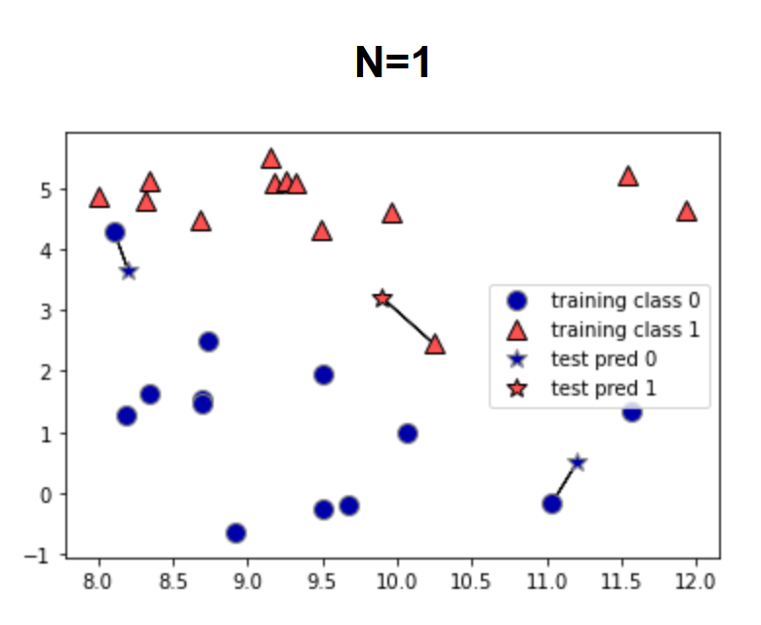
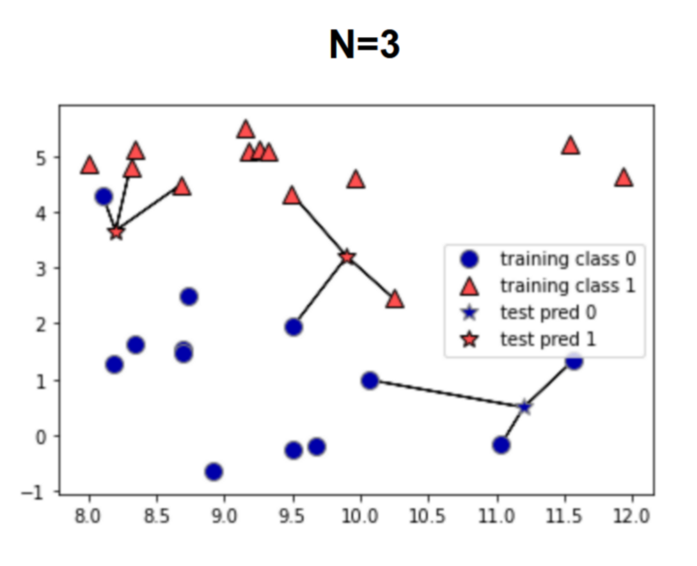
Linear Models - Classifiers
K-Nearest Neighbors
  Graphs below show decision, generated in source (1). The stars are the test data, and the model is predicting whether they are blue or red.

Slide 7
Linear Models - Classifiers
In-Class Exercise
  Run the classifier example with k-nearest neighbors and optimize based on number of neighbors.
    Use the .score() return value as your accuracy metric.

Slide 8
Linear Models - Classifiers
Decision Tree
  Builds a series of if-statements to classify test points.
  Boundaries around classifications are built based on the data.
  The number of if statement groups, or boundaries created, is known as the depth.

Slide 9
Linear Models - Classifiers
Decision Tree
  See file “./Session 7 – Python/Instructional Material/Class Examples/Scikit-Learn/decision_tree_graph.html“ for a representation of how the decision tree classifies from data.
    Generated from iris data set
    Code can be found in class example code under the decision tree section

Slide 10
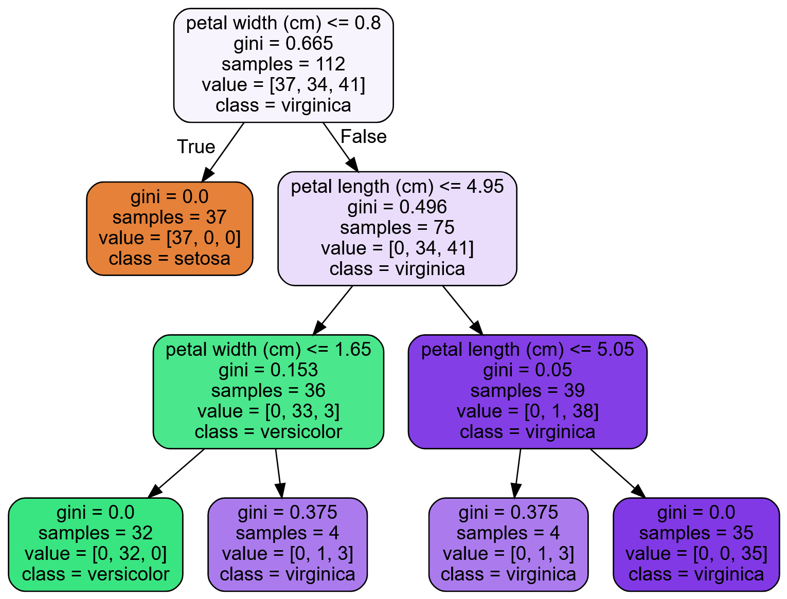
Linear Models - Classifiers
Decision Tree

Slide 11
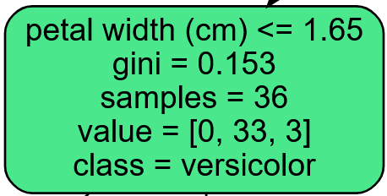
Linear Models - Classifiers
Decision Tree
  Attributes
    First line is the decision criteria for the children notes of the node the condition appears in.

Slide 12
Linear Models - Classifiers
Decision Tree
  Attributes
    Gini – A measure of the impurity of the node. 0 means all predictions are the same class, 1 means an infinite number of samples are classified in an infinite number of labels.

Slide 13
Linear Models - Classifiers
Decision Tree
  Attributes
    Gini
      = 1 -
      is the ratio of the predicted class to all samples of the kth class for the ith node.
      Closer to zero means most of the predicted labels are one class.
      Closer to one means the predicted labels are across more classes.

Slide 14
Linear Models - Classifiers
Decision Tree
  Attributes
    Gini
      The gini score is used in a cost function to determine which feature is used to create the decision boundary/condition for each node.

Slide 15
Linear Models - Classifiers
Decision Tree
  Attributes
    Samples – The number of training sets used to predict the current node.
    Value – The predicted classes with the given samples. This is in the order of the dataset label names.

Slide 16
Linear Models - Classifiers
Decision Tree
  Attributes
    Class – The predicted label of this node.

Slide 17
Linear Models - Classifiers
Decision Tree
  Tends to overfit the data.
  Can control this (regularize) by modifying the following parameters:
    max_depth
      The maximum depth the tree can go do.
    max_leaf_nodes
      Maximum number of leaves allowed in the model.
    max_features
      The number of features used in determining a node split.
Notes:
max_depth – The maximum number of node levels to generate.
max_leaf_nodes – The maximum number of leaves that can occur in the tree.
max_features – Maximum number of features that are evaluated for splitting each node.
min_samples_split – Minimum number of samples a node must have before it can split into another depth.
min_samples_leaf – The minimum number of samples a leaf node must have to exist.
min_weight_fraction_leaf – Same as min_samples_leaf, but uses a weighted fraction instead of sample count.

Slide 18
Linear Models - Classifiers
Decision Tree
  Tends to overfit the data.
  Can control this (regularize) by modifying the following parameters:
    min_samples_split
      Minimum number of samples in a node before a split can occur.
    min_samples_leaf
      Minimum number of samples needed in each produced leaf.
    min_weight_fraction_leaf
      The minimum weight with respect to the total weight a leaf can have in order for the leaf to exist.
Notes:
max_depth – The maximum number of node levels to generate.
max_leaf_nodes – The maximum number of leaves that can occur in the tree.
max_features – Maximum number of features that are evaluated for splitting each node.
min_samples_split – Minimum number of samples a node must have before it can split into another depth.
min_samples_leaf – The minimum number of samples a leaf node must have to exist.
min_weight_fraction_leaf – Same as min_samples_leaf, but uses a weighted fraction instead of sample count.

Slide 19
Linear Models - Classifiers
Decision Tree
  Sensitive to data
    Removing/adding one data point can drastically change the decision boundaries.
Notes:
max_depth – The maximum number of node levels to generate.
max_leaf_nodes – The maximum number of leaves that can occur in the tree.
max_features – Maximum number of features that are evaluated for splitting each node.
min_samples_split – Minimum number of samples a node must have before it can split into another depth.
min_samples_leaf – The minimum number of samples a leaf node must have to exist.
min_weight_fraction_leaf – Same as min_samples_leaf, but uses a weighted fraction instead of sample count.

Slide 20
Linear Models - Classifiers
Decision Tree
  Sensitive to data orientation
    This applies more for regression.
    Boundaries for decision trees are orthogonal (i.e. they are vertical or lateral, but not angled).
    Rotating the data points on a graph can drastically change the decision boundaries.
Notes:
max_depth – The maximum number of node levels to generate.
max_leaf_nodes – The maximum number of leaves that can occur in the tree.
max_features – Maximum number of features that are evaluated for splitting each node.
min_samples_split – Minimum number of samples a node must have before it can split into another depth.
min_samples_leaf – The minimum number of samples a leaf node must have to exist.
min_weight_fraction_leaf – Same as min_samples_leaf, but uses a weighted fraction instead of sample count.

Slide 21

Linear Models - Classifiers
In-Class Exercise
  Run the decision tree classifier example. Play with the depth to build accuracy, using at least 1-6 depths. Does accuracy continue to increase with depth? Why or why not?

Slide 22
Linear Models - Classifiers
Logistic Regression
  Used for classification, even though the name has “regression” in it.
  Works similar to other linear regressors, using a linear equation to generate decision boundaries/predict the label of the data point.

Slide 23
Linear Models - Classifiers
Logistic Regression
  Estimates probability that a sample belongs to a classification or not.
  If the probability is over 50%, then the sample is the label.
  Since this trainer can only tell if the sample either is the label or not, this trainer can only be used for binary classification.

Slide 24
Linear Models - Classifiers
Logistic Regression
  Uses regularization parameter c
  Logistic regression defaults to using L2 regularization, but L1 can be chosen.
    More will be discussed on regularization in the following section.

Slide 25
Linear Models - Classifiers
Logistic Regression
  High c value
    Less regularization
    Model tries to fit training set more closely
    Each feature is stressed in the weighting

Slide 26
Linear Models - Classifiers
Logistic Regression
  Low c value
    More regularization
    Each weight is brought closer to zero, which minimizes the importance of each individual feature on the overall label prediction.
    Model stresses generalization, and adjusts to hit the majority of points more than each one
      Too much regularization can cause the model to miss points that are close to both categories.

Slide 27
Linear Models - Classifiers
In-class Example
  Logistic Regression

Slide 28
Linear Models - Classifiers
In-Class Exercise
  Optimize c for logistic regression.

Slide 29
Linear Models - Classifiers
Regularization
  Trainers can use either a cost function to determine the weights of each feature, or a utility function.
    Cost functions should be minimized to determine weights.
    Utility functions should be maximized to determine weights.
  For this class, we will be using cost functions, such as Mean Squared Error or Ordinary Least Squares

Slide 30
Linear Models - Classifiers
Regularization
  A general cost function may look something like the following (Mean Squared Error):
    Cost = 1/n*[(Ŷ₁-Y₁)² + (Ŷ₂-Y₂)² + (Ŷ₃-Y₃)² + … + (Ŷ_{n}-Y_{n})²]
      Ŷ = predicted label
      Y = actual label
      n = number of samples
      w is the determined weight
      x is the feature value
      m is the number of features

Slide 31
Linear Models - Classifiers
Regularization
  This cost function is used to calculate the weight
    Our machine learning model will use specific parameters, along with adjusting the weights of each feature, to minimize the cost function.
      Learning rate
      Predicted outcomes/labels
      Actual outcomes/labels
    Once the cost function is minimized, the feature weights have been determined and our model is trained.

Slide 32
Linear Models - Classifiers
Regularization
  Regularization adds an additional r penalty to the cost function, driving the weights closer to 0.
    Cost = 1/n*[(Ŷ₁-Y₁)² + (Ŷ₂-Y₂)² + (Ŷ₃-Y₃)² + … + (Ŷ_{n}-Y_{n})²] + r
      Ŷ = predicted label
      Y = actual label
      n = number of samples
      r = regularization penalty to cost function
      w is the determined weight
      x is the feature value
      m is the number of features

Slide 33
Linear Models - Classifiers
Regularization
  Alternative notation
    J = + r
      J = Cost Function
      Ŷ = predicted label
      Y = actual label
      n = number of samples
      r = regularization penalty to cost function
      i = Sample index parameter

Slide 34
Linear Models - Classifiers
Regularization
  Alternative notation
      Ŷ = Predicted label for the given sample
      m = Number of features
      w = Weight values
      x = Feature values
      k = Feature index parameter

Slide 35
Linear Models - Classifiers
Regularization
  L1 Regularization
    r = α
      α is a hyperparameter used to adjust how fast the weights change (in the case of logistic regression, this is the c parameter)
        α = 1/c
      w is the weight of a feature
    Can cause the weights for features to go to 0

Slide 36
Linear Models - Classifiers
Regularization
  L2 Regularization:
    r = α ²
      α is a hyperparameter used to adjust how fast the weights change
        This is the c parameter in logistic regression
        α = 1/c
      w is the weight of a feature
    Weights for features cannot go to zero, but can get as close as needed

Slide 37
Linear Models - Classifiers
Regularization
  The general effect of regularization is to flatten a curve between all the data points.
    Causes the model to better generalize to the data.

Slide 38
Linear Models - Classifiers
Regularization
  The cost function can change, and regularization can still be applied.
  We used MSE as an example for this section:
    J = + r
  Ordinary Least Squares is another cost function that can be used:
    J = + r

Slide 39
Linear Models - Classifiers
Support Vector Machine (SVM) Classifiers
  Useful for small, complex datasets
  Types
    Linear
      Create boundary line by maximizing distance between two classes.
    Nonlinear
      Use feature engineering to generate more features

Slide 40
Linear Models - Classifiers
Linear SVM
  Attempts to create decision boundaries that maximize the space between the two closest samples.

Slide 41
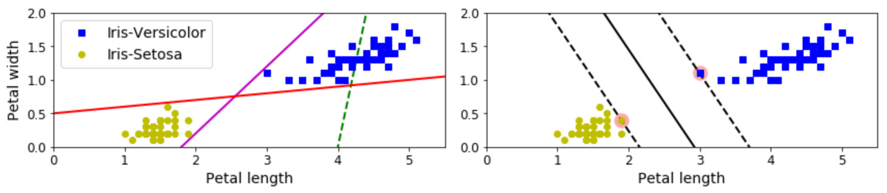
Linear Models - Classifiers
Linear SVM
  The left figure below shows individual linear classifier boundaries for multiple models
  The right figure shows the boundary for a linear SVM.
(4)

Slide 42
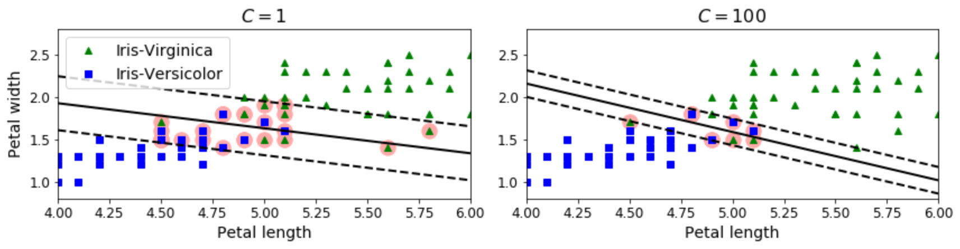
Linear Models - Classifiers
Linear SVM
  Support Vectors
    The points that generate the margin lines.
  Margin Violations
    Data points that are within the margins (dashed lines), even if they are on the correct side of the boundary.
(4)

Slide 43
Linear Models - Classifiers
Linear SVM
  Regularization
    Linear SVM’s use the c hyperparameter
    The c value changes the width of the margins from the boundary condition.
    Smaller c values increase the margins, which generalizes more

Slide 44
Linear Models - Classifiers
Linear SVM
  Regularization
    Smaller c values
      Increase the margins
      More generalized
      More margin violations
    Larger c values
      Smaller margins
      Fewer margin violations
      Less generalization
      Higher chance of overfitting to training data

Slide 45
Linear Models - Classifiers
Linear SVM
  Regularization
(4)

Slide 46
Linear Models - Classifiers
In-class Example
  Linear SVM

Slide 47
Linear Models - Classifiers
In-Class Exercise
  Use LinearSVM, adjusting C to see how this affects accuracy and generalization.

Slide 48
Linear Models - Classifiers
Nonlinear SVM
  Used when classes are not linearly separable.
  Multiple ways to deal with this.

Slide 49
Linear Models - Classifiers
Nonlinear SVM
  Feature Addition
    Adding more features can allow the data to be linearly separable.

Slide 50
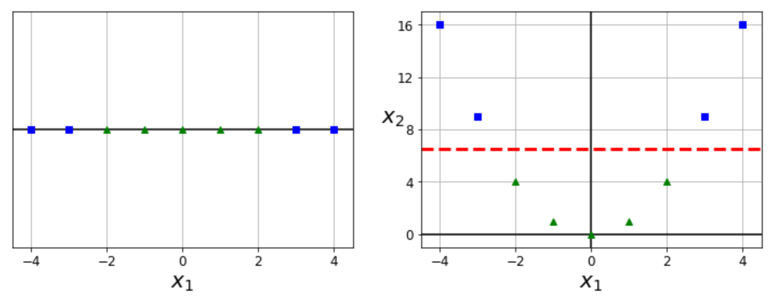
Linear Models - Classifiers
Nonlinear SVM
  Feature Addition
    The right figure results from creating a new parameter based on the squared value of the x₁ parameter.
(4)

Slide 51
Linear Models - Classifiers
Nonlinear SVM
  Feature Addition
    This new feature allows for a linearly separable boundary between the two classes.
(4)

Slide 52
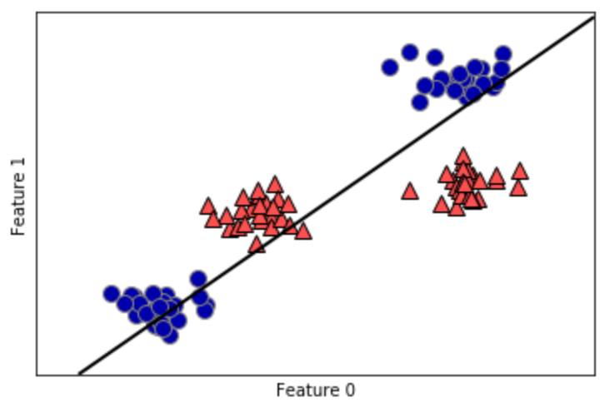
Linear Models - Classifiers
Nonlinear SVM
  Feature addition transforms this (see reference 1):
(1)

Slide 53
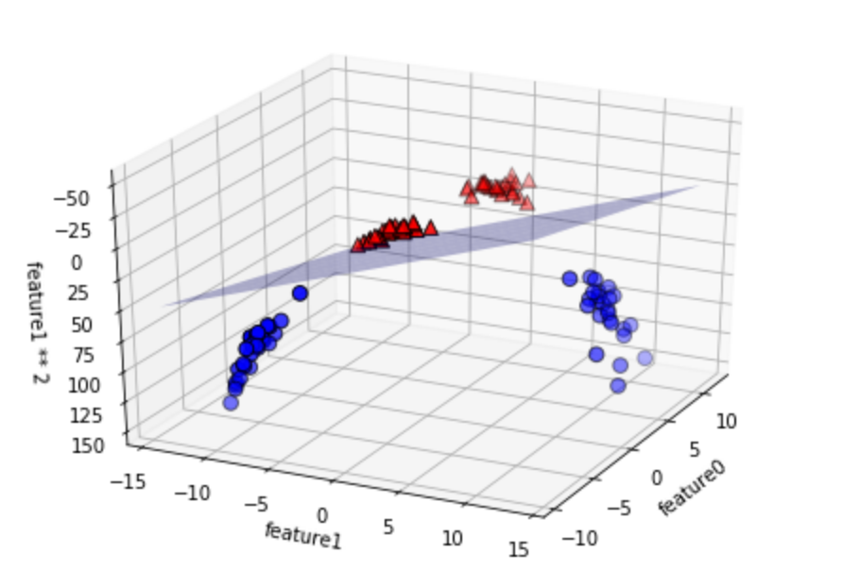
Linear Models - Classifiers
Nonlinear SVM
  To this (see reference 1):
(1)
Notes:
It is almost like the previous slide is showing a projection of this graph along just the feauture1-feature0 plane.

Slide 54
Linear Models - Classifiers
Nonlinear SVM
  Feature Addition
    Methods:
      Polynomial
      Similarity Function

Slide 55
Linear Models - Classifiers
Nonlinear SVM
  Feature Addition Using Polynomial Functions
    Addition of features using a polynomial function with another feature as an input.
    A polynomial function is of the form:
    The previous figures show graphical examples using polynomial functions.

Slide 56
Linear Models - Classifiers
Nonlinear SVM
  Feature Addition using Similarity Function
    A similarity function is used vs a polynomial function.
    The similarity function measures how much each feature data point resembles a user-specified landmark.
      The closer the data point is to a landmark, the higher the value from the similarity function.
      Can select as many feature data points to be landmarks as desired, but this increases the amount of data to predict from.
      The more landmarks chosen, the higher the linearity of the data since the number of dimensions increases.

Slide 57
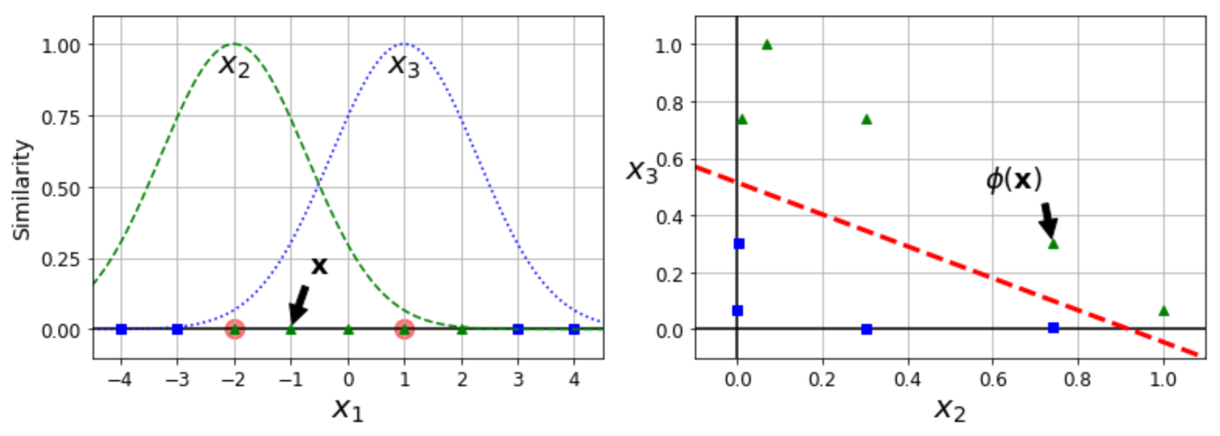
Linear Models - Classifiers
Nonlinear SVM
  Feature Addition using Similarity Function
    The following example uses the Gaussian Radial Basis Function as the similarity function, as an example.
(4)

Slide 58
Linear Models - Classifiers
Nonlinear SVM
  Feature Addition using Similarity Function
    The landmarks chosen here are -2 and 1.
(4)

Slide 59
Linear Models - Classifiers
Nonlinear SVM
  gamma (γ) hyperparameter
    Used for Gaussian RBF kernel
    Causes width of bell curves to tighten
    Causes decision boundary to wrap more tightly around the targeted class/landmarks.
    Acts like the hyperparameter c
    Higher values decrease generalization, and attempt to more exactly fit the data
    Lower values increase generalization.

Slide 60
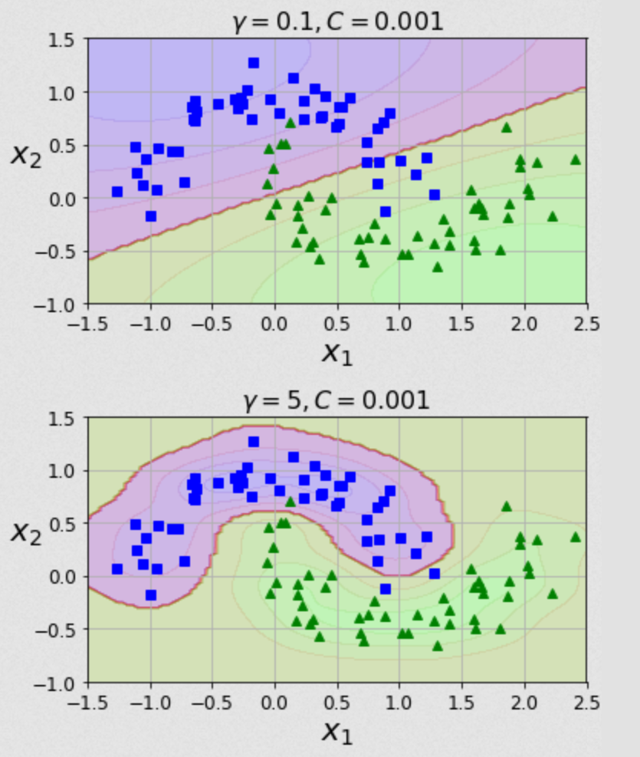
Linear Models - Classifiers
Nonlinear SVM
  gamma (γ)
hyperparameter
(4)

Slide 61
Linear Models - Classifiers
Nonlinear SVM
  Kernel Trick
    Adding more features can allow the data to be linearly separable, but also increases the amount of computational power needed.
    The kernel trick does some mathematical trickery to map the prediction function to a different space.
    Mapping the function to a different space allows a less computationally expensive calculation vs computing values for the function itself.
    This decreases the needed computational power.

Slide 62
Linear Models - Classifiers
Nonlinear SVM
  Kernel Trick
    Different kernels can be used, including for polynomial and similarity function methods covered above.
    See code for examples.

Slide 63
Linear Models - Classifiers
In-class Example
  Nonlinear SVM using feature addition
  Nonlinear SVM using kernels

Slide 64
Linear Models - Classifiers
In-Class Exercise
  Optimize the polynomial degree for nonlinear SVM using the polynomial kernel.
  Use the RBF kernel with the nonlinear SVM, adjusting gamma and C to see how they affect accuracy and generalization.

Slide 65

Bibliography
https://github.com/amueller/introduction_to_ml_with_python/blob/master/02-supervised-learning.ipynb
Müller, A. C., & Guido, S. (2016). Introduction to Machine Learning with Python: A Guide for Data Scientists (1st ed.). O’Reilly Media.
http://rasbt.github.io/mlxtend/user_guide/general_concepts/gradient-optimization/

Slide 66
Bibliography
https://github.com/ageron/handson-ml
Géron Aurélien. Hands-on Machine Learning with Scikit-Learn and Tensorflow. 1st ed., O'Reilly, 2017.
https://machinelearningmastery.com/how-to-use-correlation-to-understand-the-relationship-between-variables/

Slide 67
Bibliography
Harrison, Matt. Machine Learning Pocket Reference: Working with Structured Data in Python. 1st ed., O'Reilly, 2019.
https://scikit-learn.org/stable/modules/cross_validation.html
Scikit-learn: Machine Learning in Python, Pedregosa et al., JMLR 12, pp. 2825-2830, 2011.

Slide 68
Bibliography
API design for machine learning software: experiences from the scikit-learn project, Buitinck et al., 2013.
https://docs.scipy.org/doc/scipy/reference/generated/scipy.stats.pearsonr.html
https://docs.scipy.org/doc/scipy/reference/generated/scipy.stats.spearmanr.html#scipy.stats.spearmanr

Slide 69
Bibliography
https://www.investopedia.com/terms/p/p-value.asp
https://scikit-learn.org/stable/auto_examples/manifold/plot_swissroll.html#sphx-glr-auto-examples-manifold-plot-swissroll-py
https://scikit-learn.org/stable/auto_examples/manifold/plot_compare_methods.html#sphx-glr-auto-examples-manifold-plot-compare-methods-py

Slide 70
Bibliography
16) https://wizardforcel.gitbooks.io/scikit-and-tensorflow-workbooks-bjpcjp/content/ch08-dimensionality-reduction.html
17) https://pub.towardsai.net/principal-component-analysis-in-dimensionality-reduction-with-python-1a613006d531
18) https://towardsdatascience.com/the-kernel-trick-c98cdbcaeb3f

Slide 71
Bibliography
19) https://cs.nyu.edu/~roweis/lle/papers/lleintro.pdf
20)https://docs.python.org/3/library/json.html
21)https://academic.oup.com/bioinformatics/article/24/18/2010/190849?login=false
22)https://arxiv.org/pdf/1904.10416.pdf
23)

Slide 72
Additional Resources
https://towardsdatascience.com/over-fitting-and-regularization-64d16100f45c
https://towardsdatascience.com/scale-standardize-or-normalize-with-scikit-learn-6ccc7d176a02

Slide 73
LICENSE
Copyright 2022 Douglas Bowman
Permission is hereby granted, free of charge, to any person obtaining a copy of this software and associated documentation files (the "Software"), to deal in the Software without restriction, including without limitation the rights to use, copy, modify, merge, publish, distribute, sublicense, and/or sell copies of the Software, and to permit persons to whom the Software is furnished to do so, subject to the following conditions:
The above copyright notice and this permission notice shall be included in all copies or substantial portions of the Software.
THE SOFTWARE IS PROVIDED "AS IS", WITHOUT WARRANTY OF ANY KIND, EXPRESS OR IMPLIED, INCLUDING BUT NOT LIMITED TO THE WARRANTIES OF MERCHANTABILITY, FITNESS FOR A PARTICULAR PURPOSE AND NONINFRINGEMENT. IN NO EVENT SHALL THE AUTHORS OR COPYRIGHT HOLDERS BE LIABLE FOR ANY CLAIM, DAMAGES OR OTHER LIABILITY, WHETHER IN AN ACTION OF CONTRACT, TORT OR OTHERWISE, ARISING FROM, OUT OF OR IN CONNECTION WITH THE SOFTWARE OR THE USE OR OTHER DEALINGS IN THE SOFTWARE.

